Slide 1
Super Market Sales Analysis

Slide 2
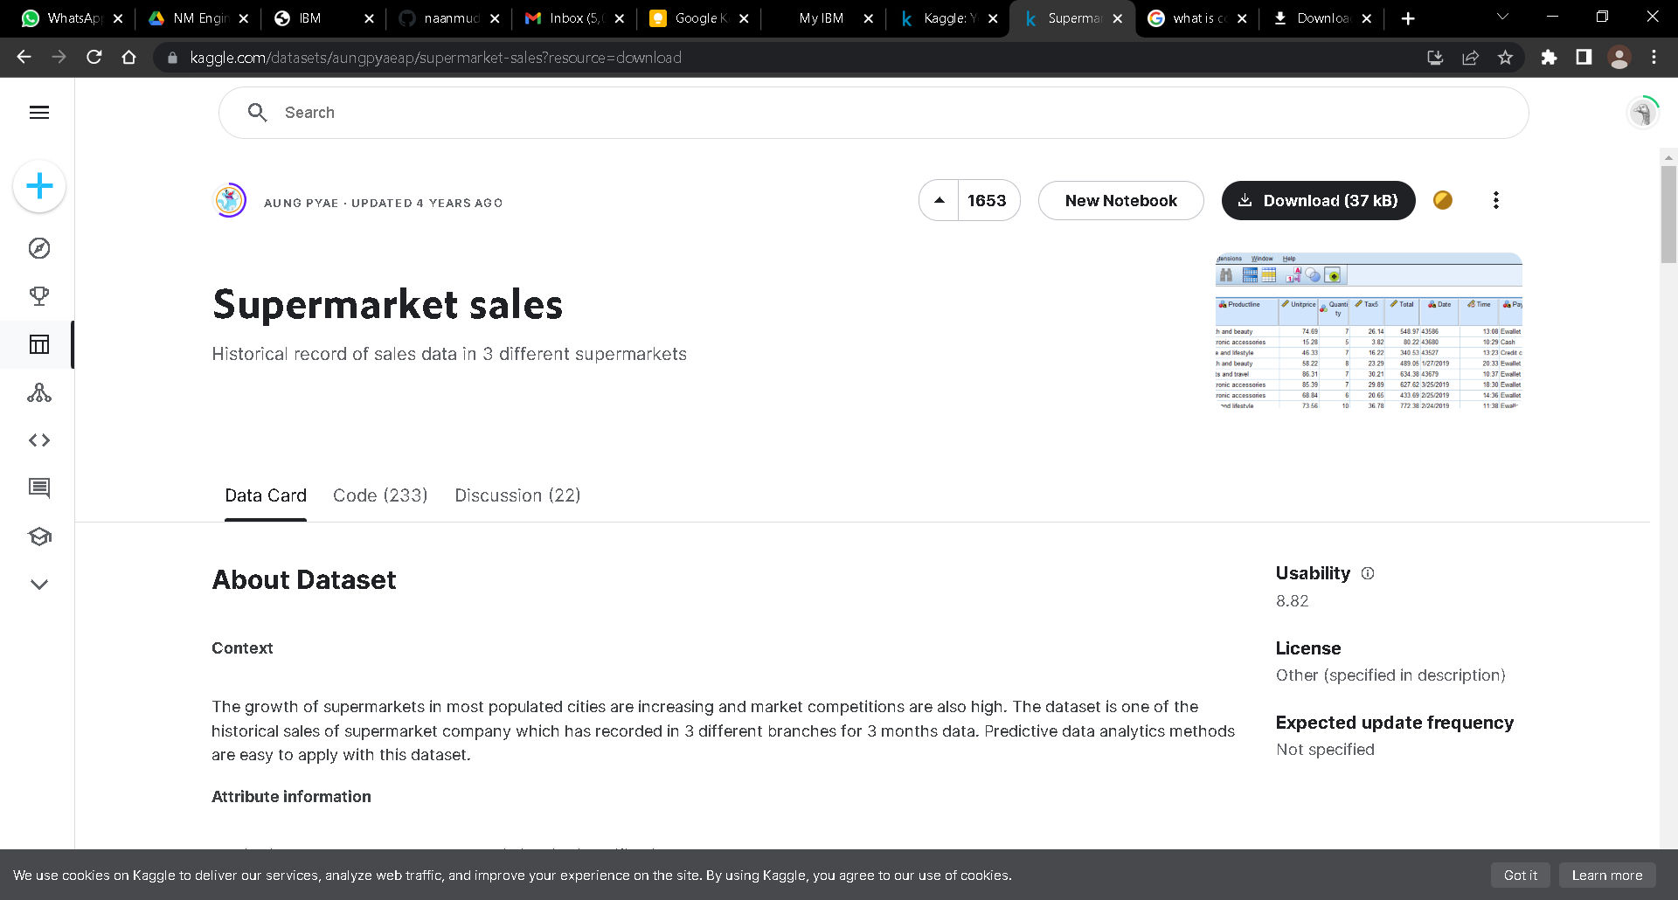
About Dataset
The growth of supermarkets in most populated cities is increasing and market competitions are also high.
The dataset is one of the historical sales of supermarket company which has recorded in 3 different branches for 3 months data.
Here is the image of dataset window in kaggle.com website.

Slide 3
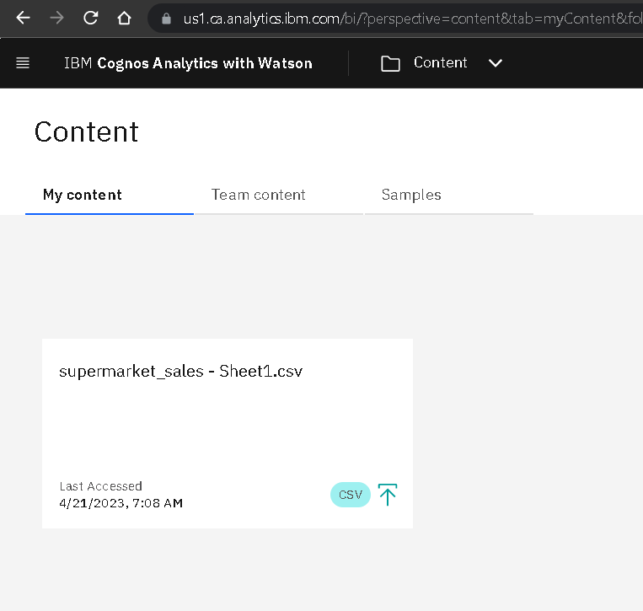
Uploading data set to Cognos Data Analytics
Here are snapshots of how I upload .csv files to my Cognos data analytics
Downloaded .csv file from kaggle is uploaded using the upload feature on the cognos website.

Slide 4
Delete the unnecessary columns
Below are the Snapshots
Removal of unnecessary coloumns are done here and they have been saved as another data module .
You can see that few columns are not displayed as they have been removed.

Slide 5
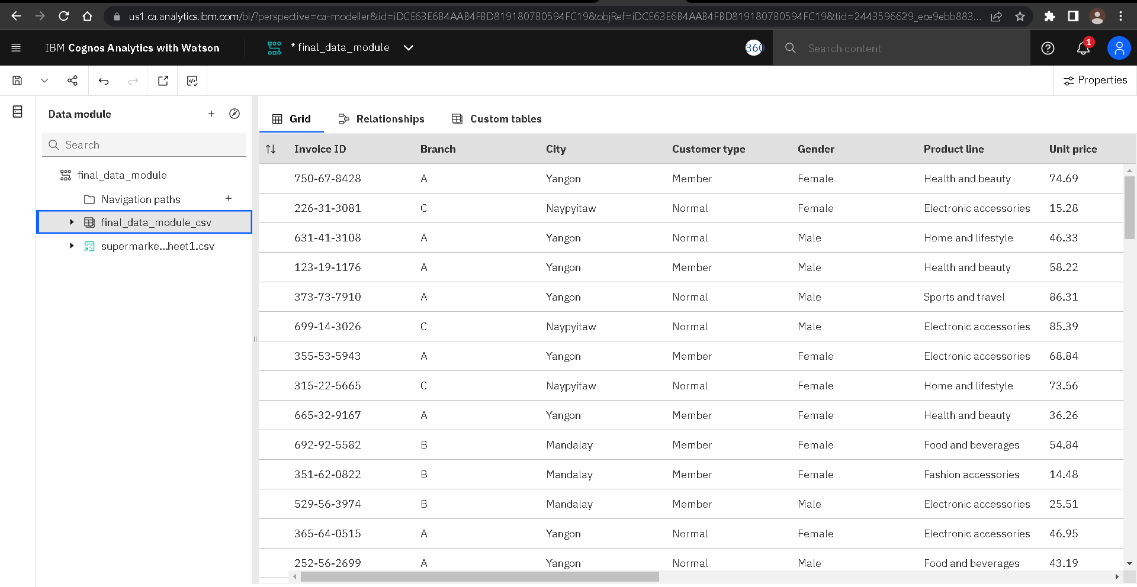

Slide 6
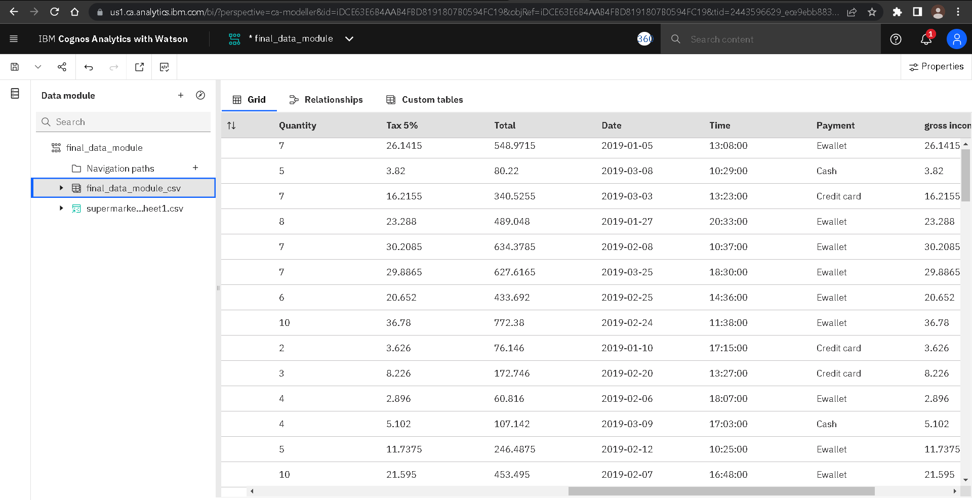

Slide 7
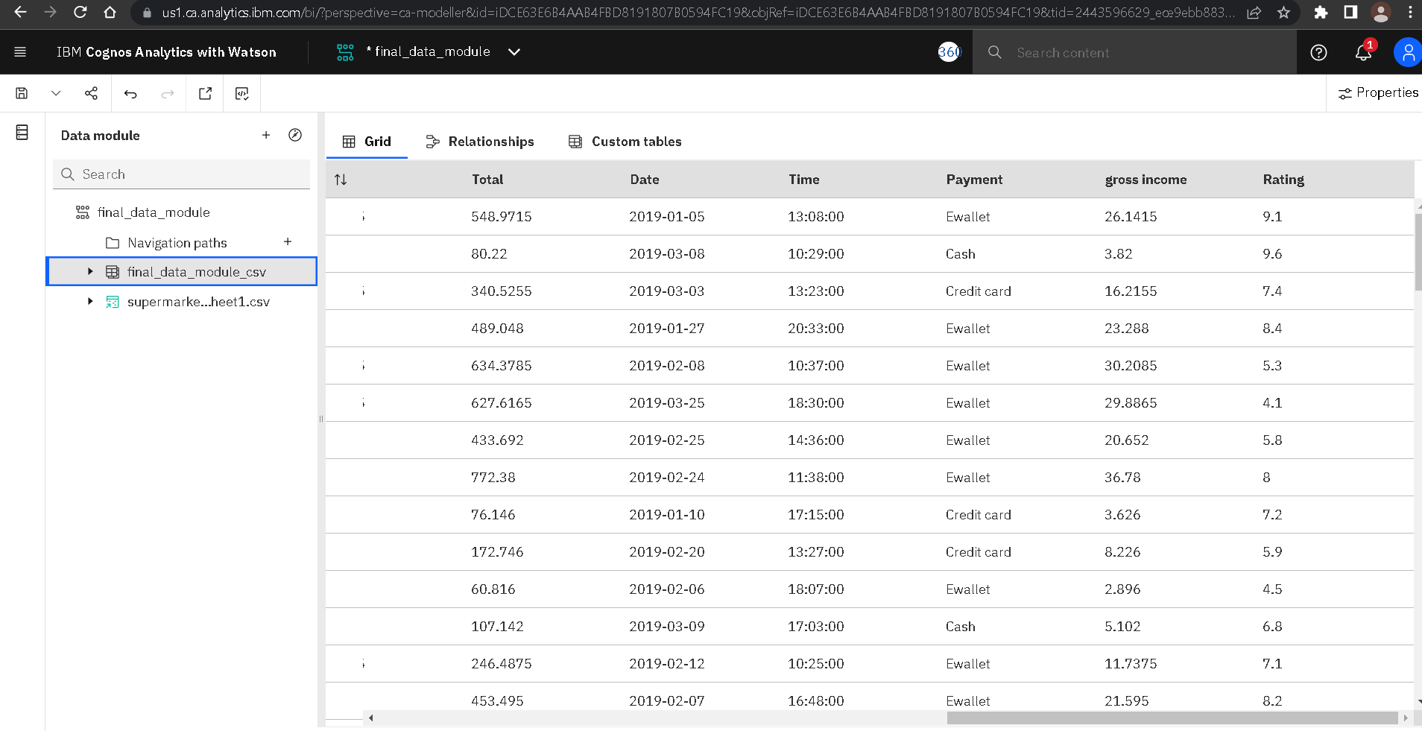

Slide 8
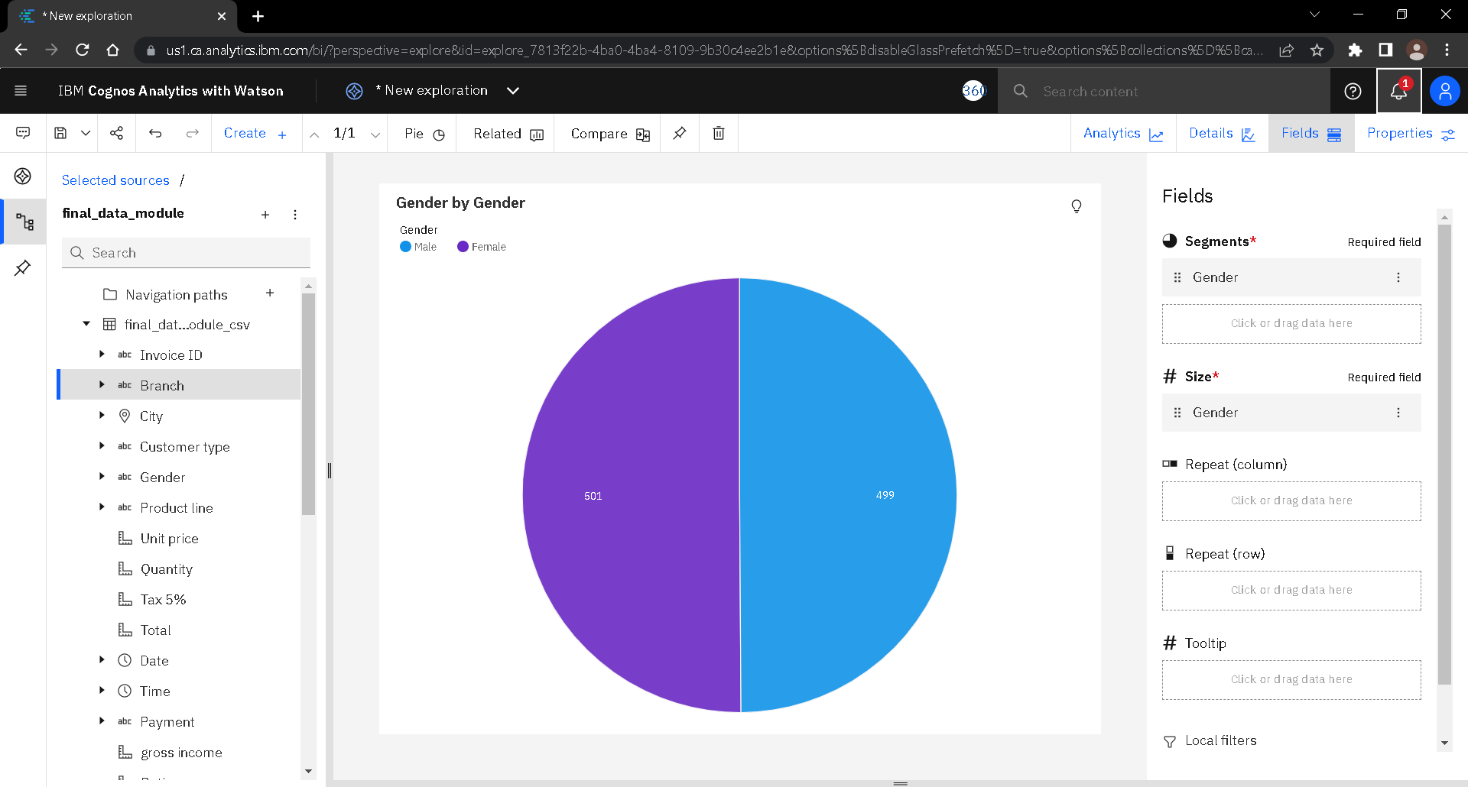
Analysis of Gender by Gender in a Pie Chart Representation
The diagram is a Pie Chart representation of Genders of two kinds.
Hence it has two colours.

Slide 9
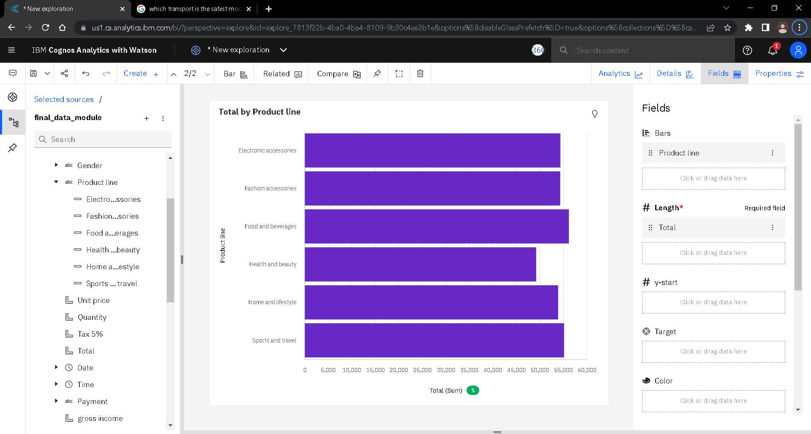
Analysis of quantity of products
According to Diagram we can see we having more amount of Electronic accessories product

Slide 10
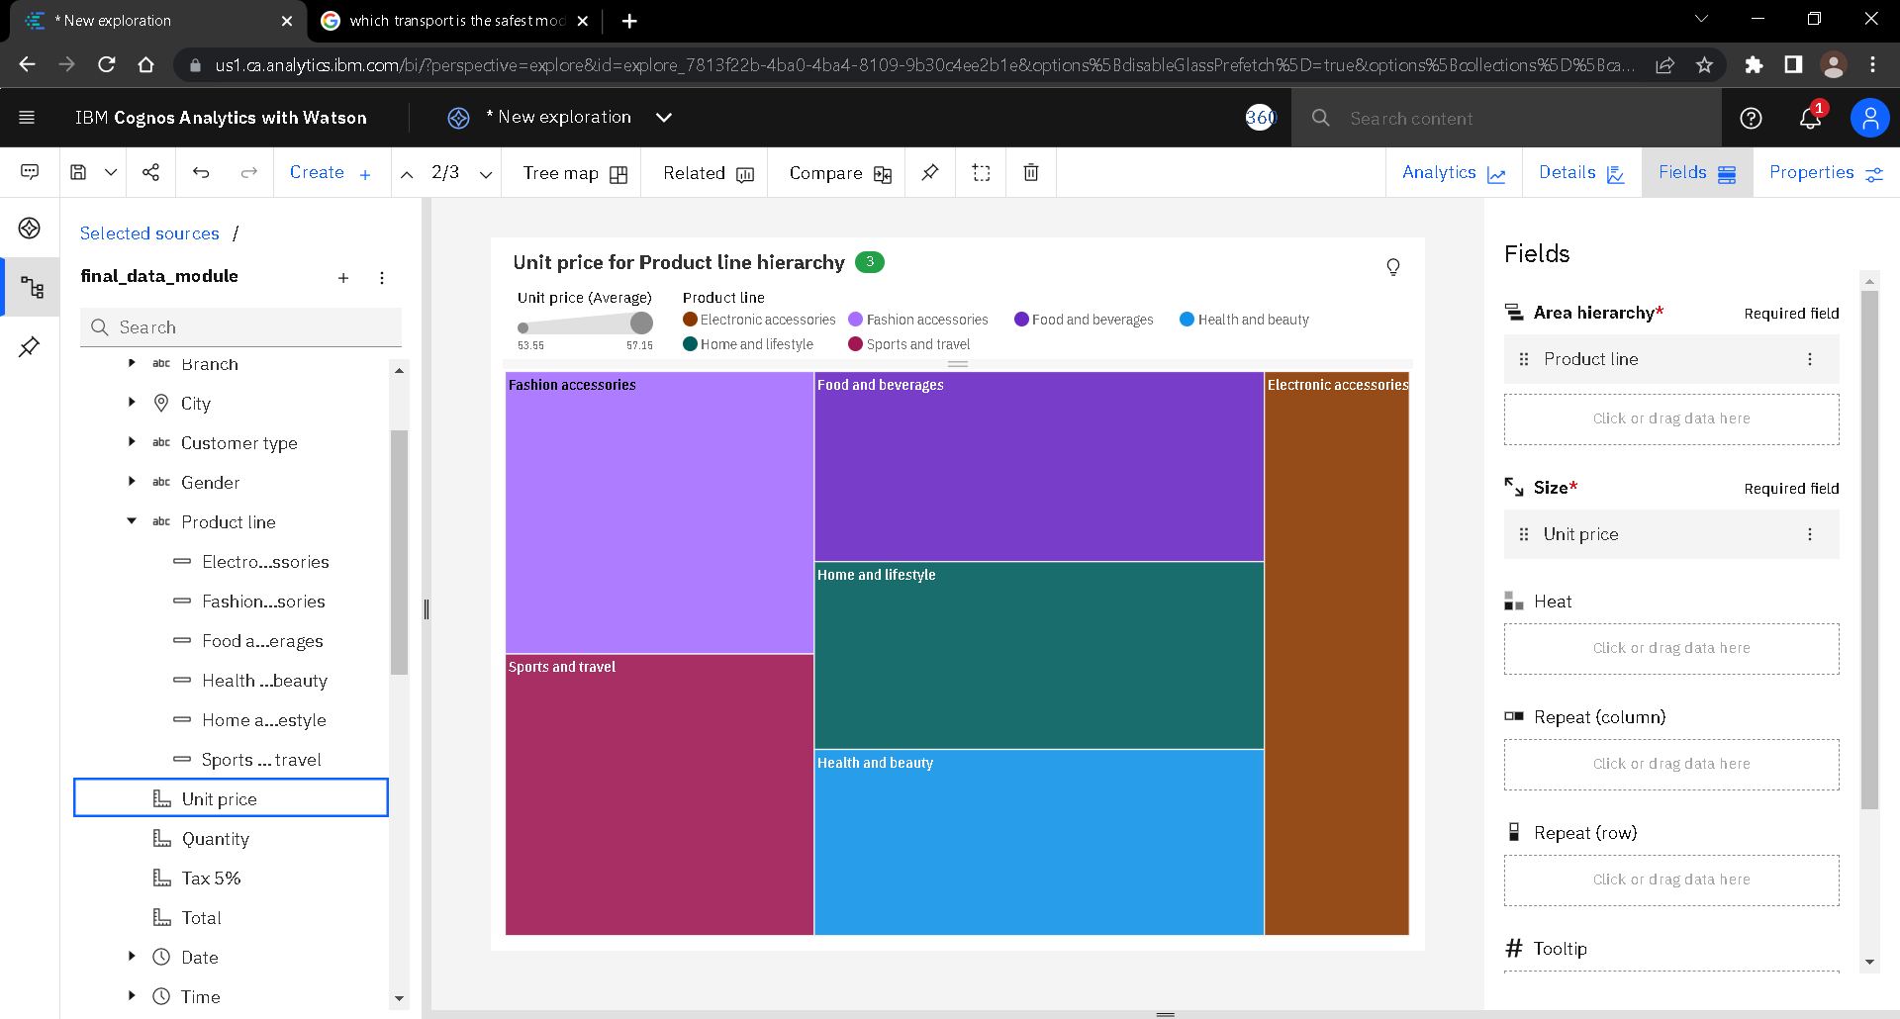
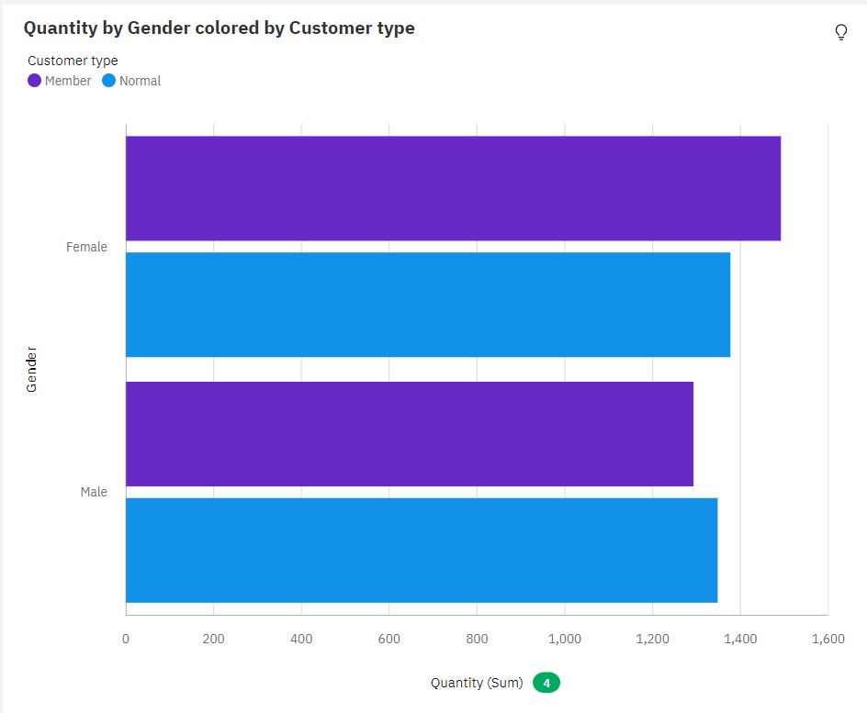
Analysis of Gender and Customer type
The Diagram showing the more number of products purchased by female who are members.

Slide 11
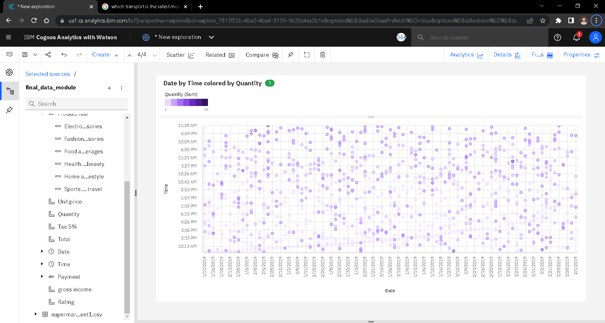
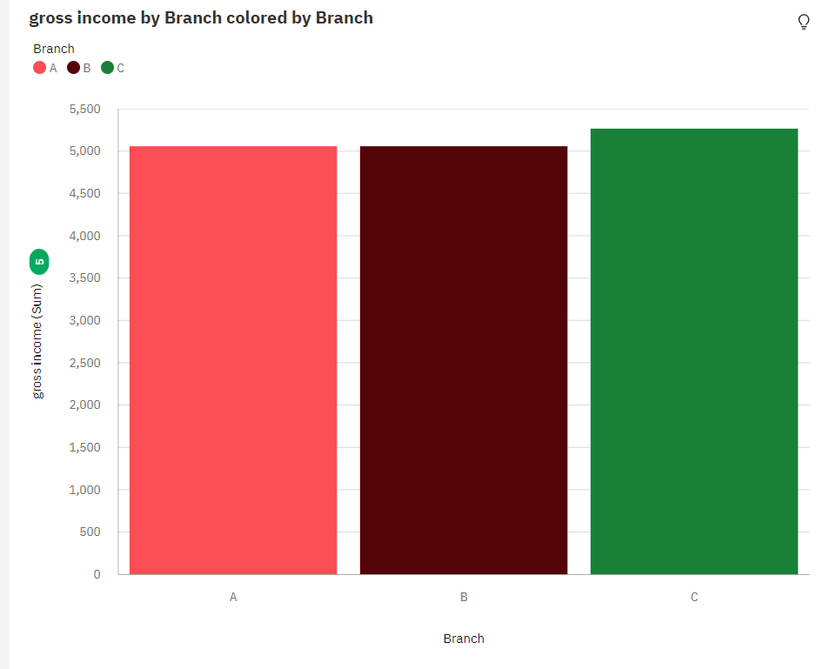
Analysis of gross income
The Diagram is showing the Branch “C” is making more gross income .

Slide 12
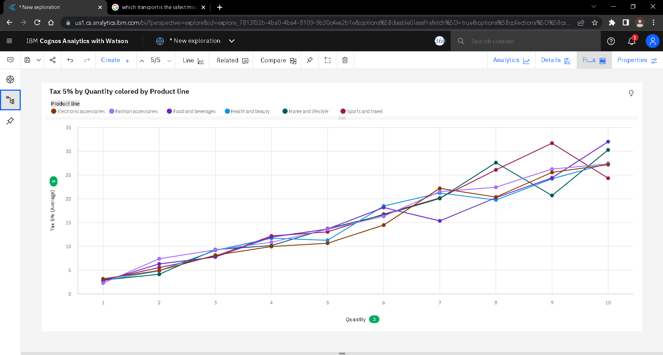
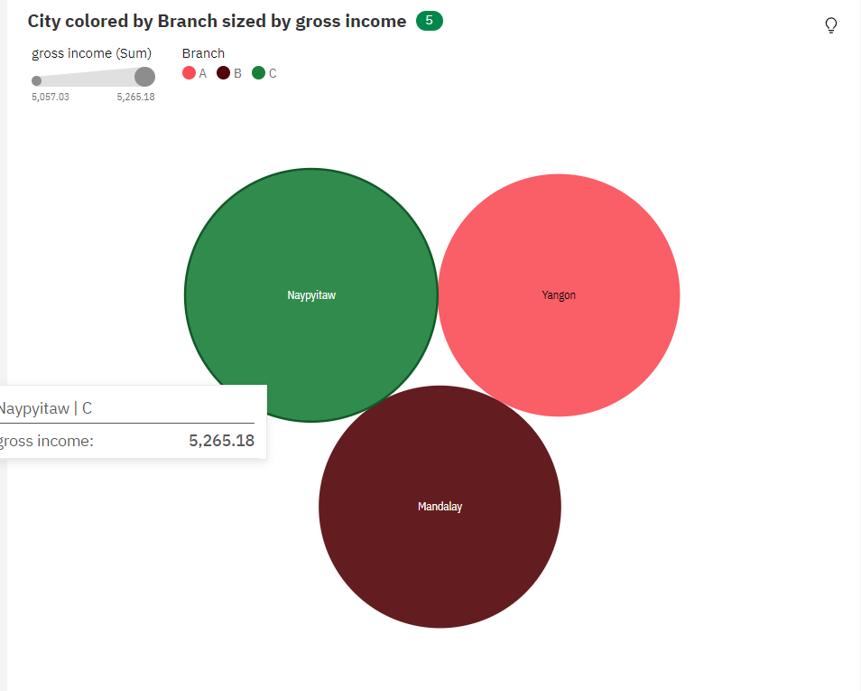
Analysis of gross income including it’s city and branch
The diagram is showing that in city “Naypiyaw” the branch “C” is Giving more gross income .

Slide 13
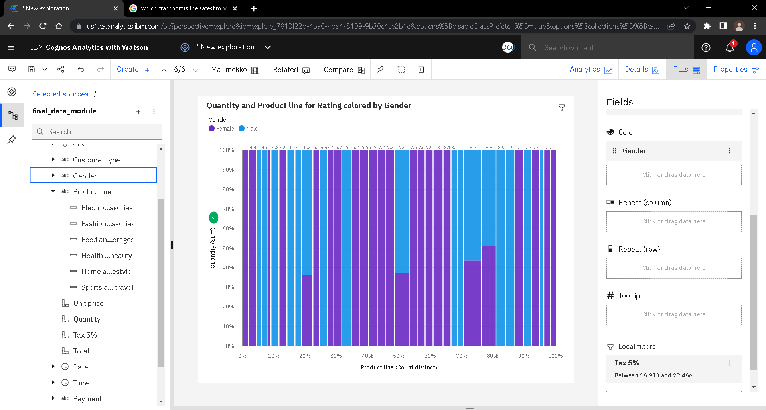
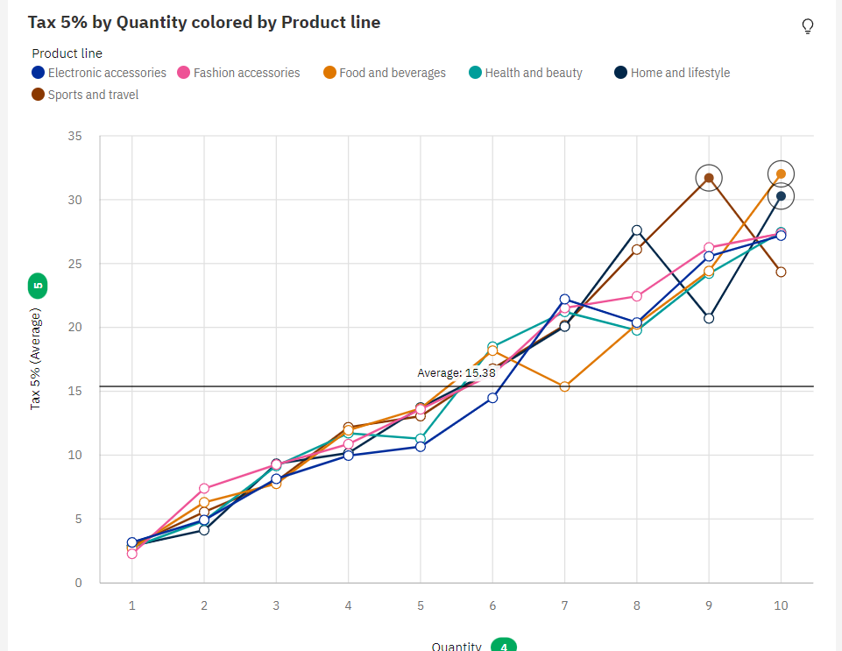
Analysis of Taxes according to the quantity of products
The diagram is showing as number of Quantity is increasing the Tax also increasing

Slide 14
Conclusion
Data Analysis for Super Market is done successfully by uploading the dataset to Cognos Analytics, deleting the unnecessary columns, creating a data module, exploring and visualization of the dataset.
By Melvin S (310820104701) - Jeppiaar Engineering College
Team – 01 -- Data Analytics
Team lead -- Nivethitha S
Team member 01 -- Melvin S
Team Member 02 -- Nanditha M
Team Member 03 -- Roopesh M
Thank you .

